Slide 1
Embedded System Design CodeVisionAVR Compiler & ISIS Professional Simulator Tools Work Flow→Step By Step
By Md.Dedarul Hasan,
PGD in IT (Student), April 2017, IICT BUET.

Slide 2
1st Step:
Install CodeVision AVR with crack version or latest with .[We can extend CVAVR by CodeVisionStudio]
Install Proteus Simulators latest version.

Slide 3
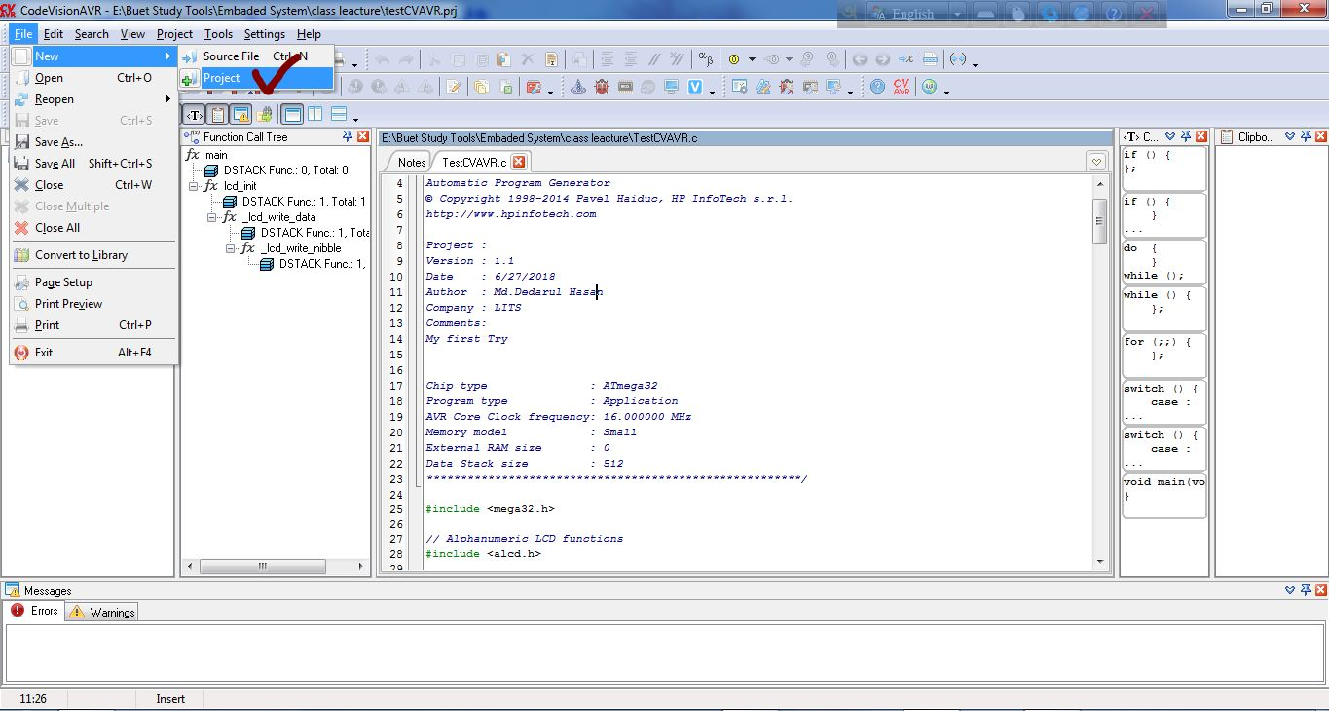
` 2nd Step: Creating a project at CVAVR. Go to file->new->project->

Slide 4
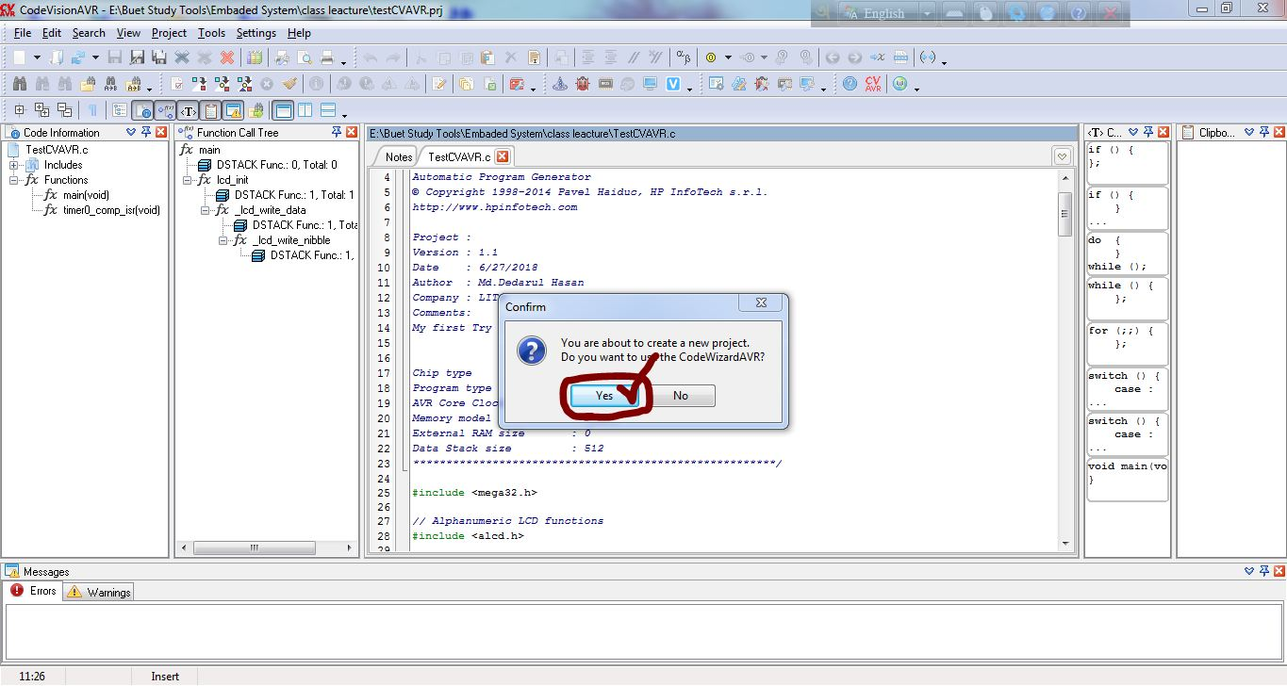
3rd Step:

Slide 5
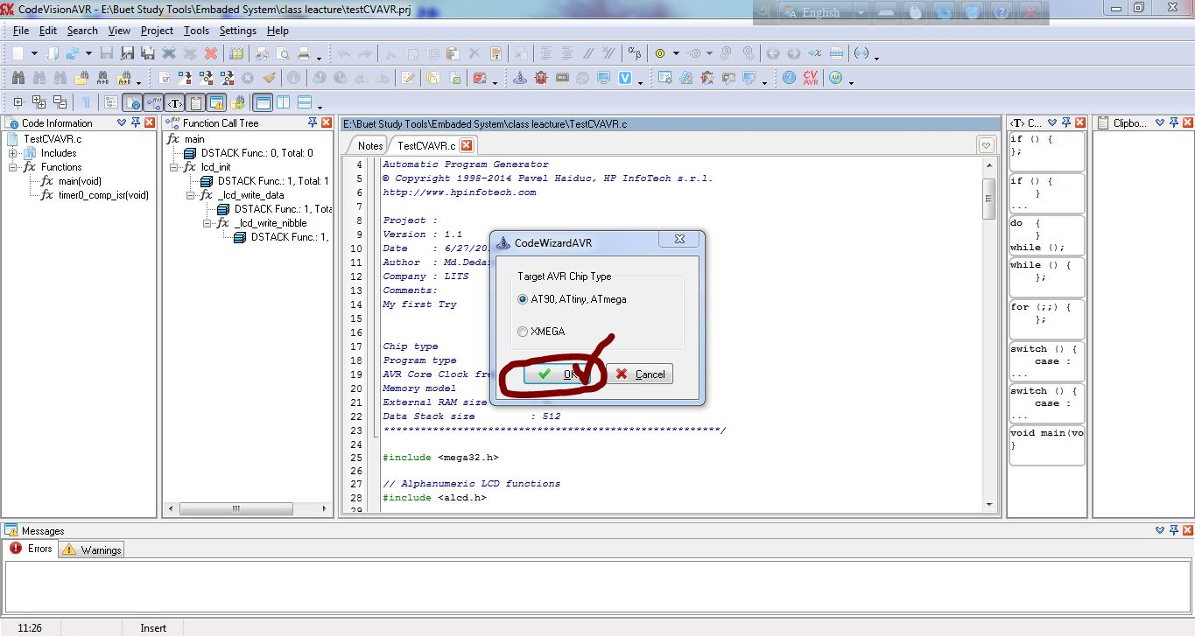
4th Step:

Slide 6
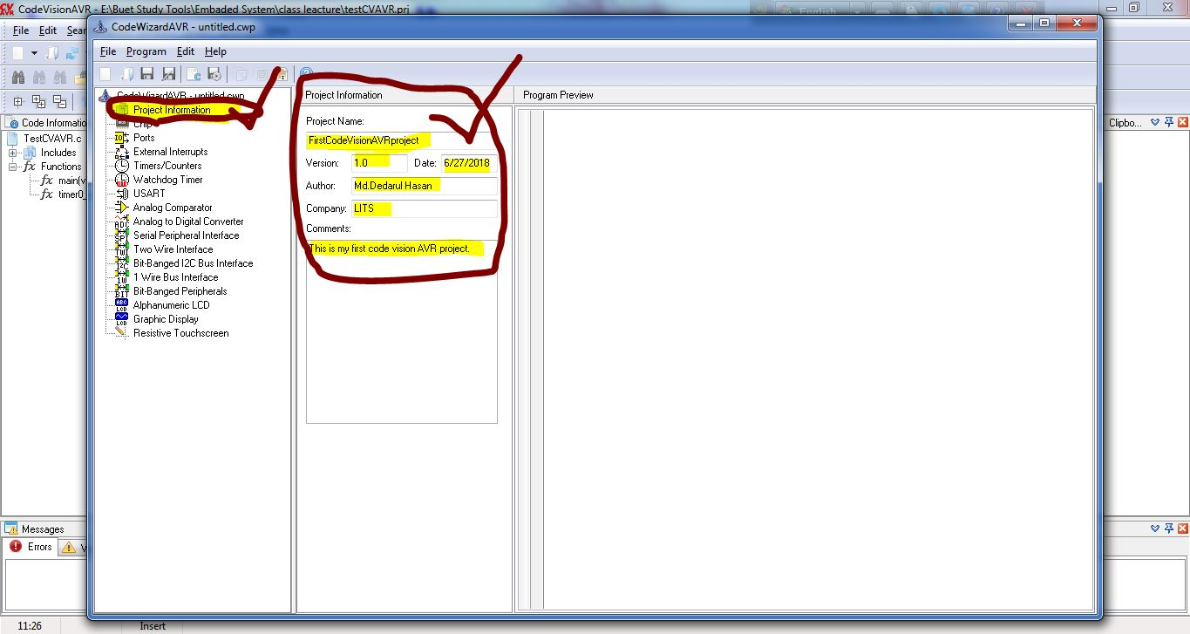
5th Step:

Slide 7
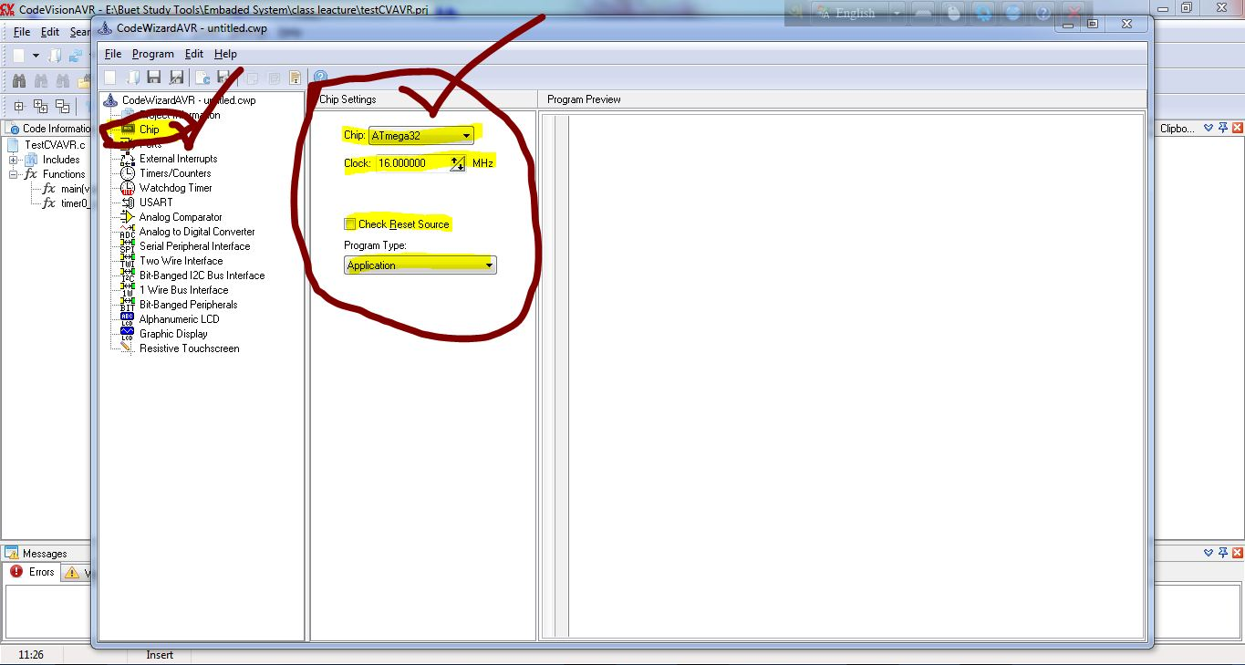
6th Step:

Slide 8
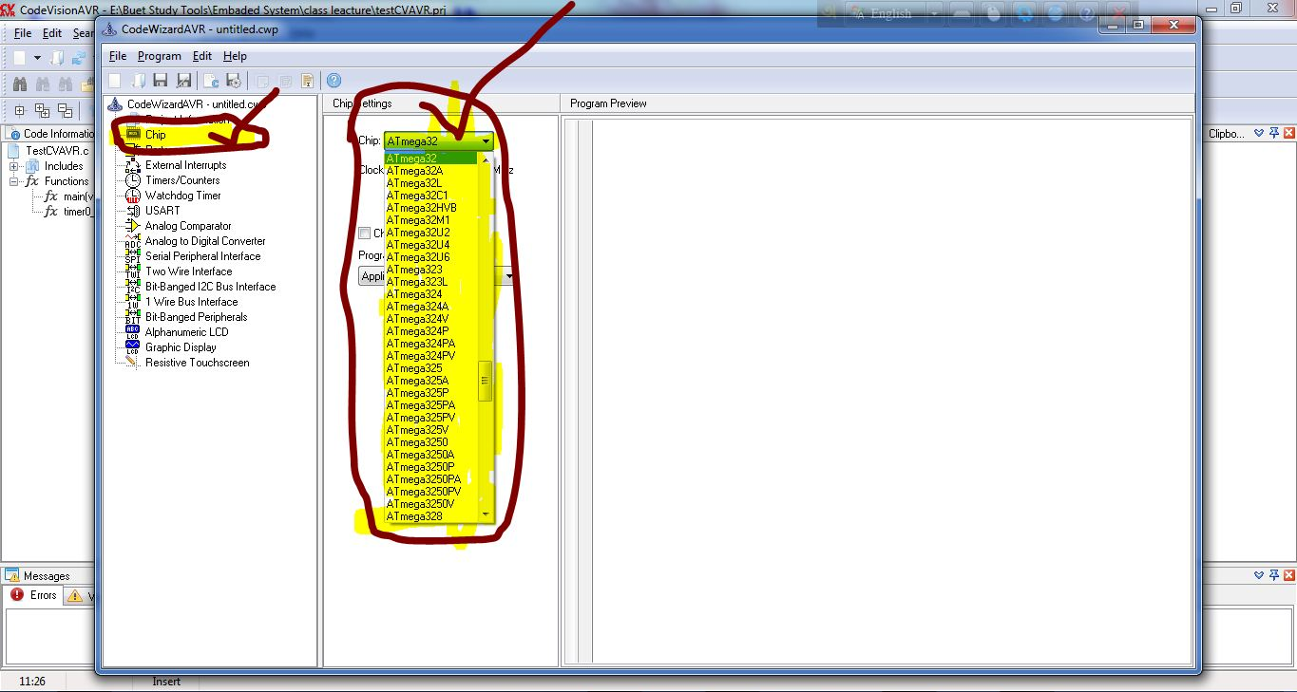
7th Step:

Slide 9
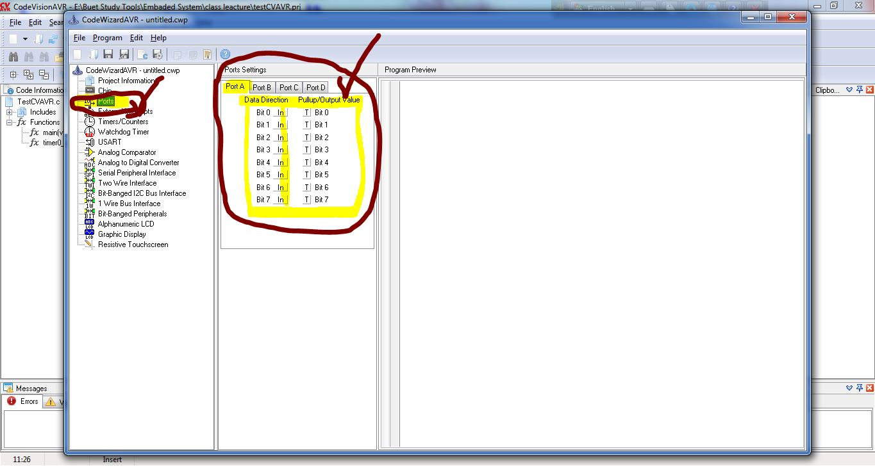
8th Step:

Slide 10
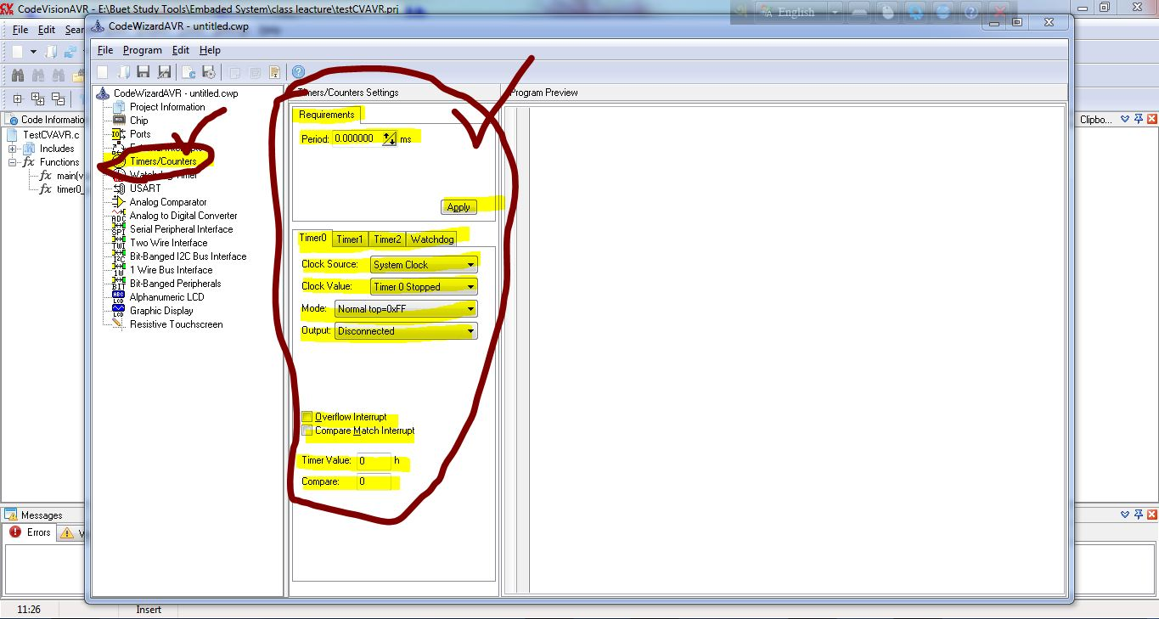
9th Step:

Slide 11
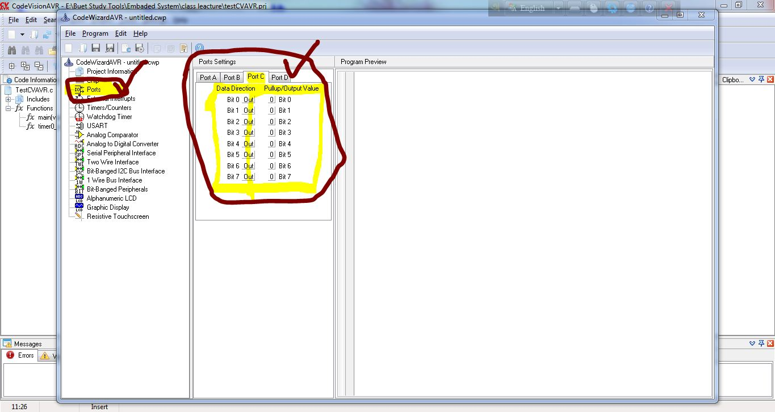
10th Step:

Slide 12
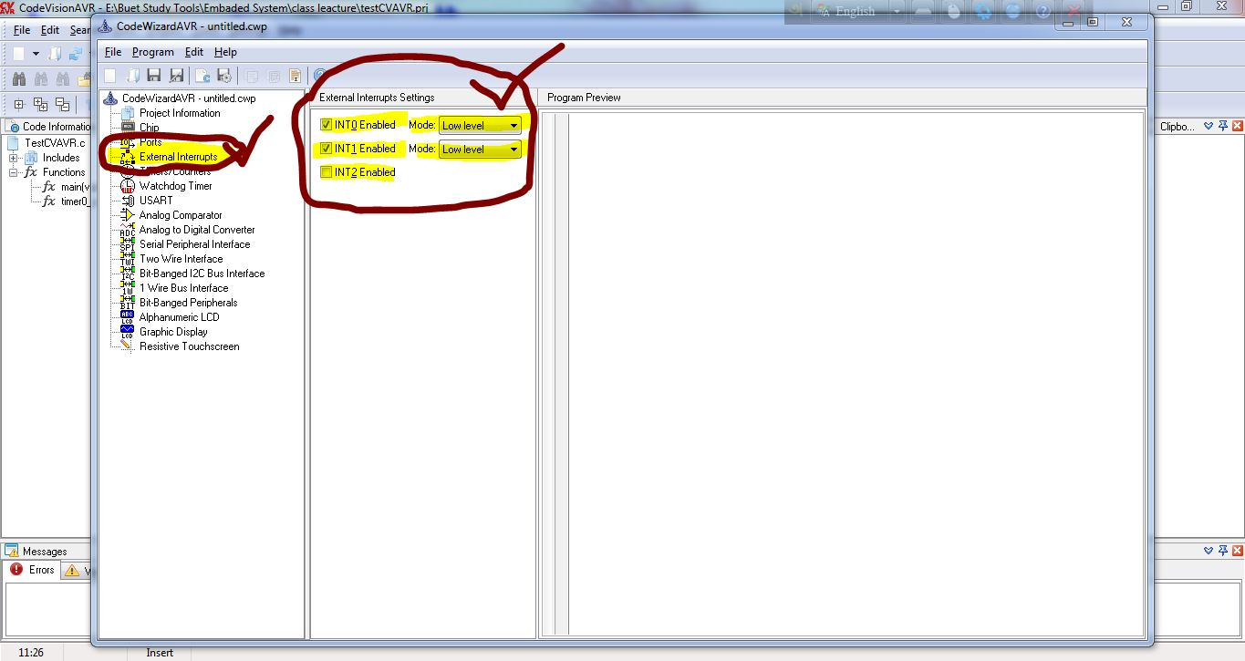
11th Step:

Slide 13
12th Step:

Slide 14
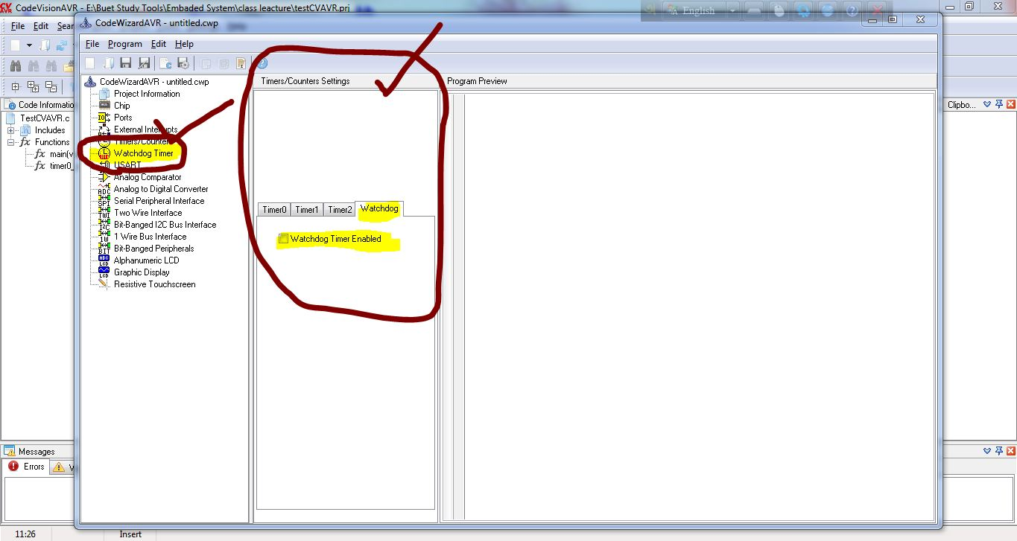
13th Step:

Slide 15
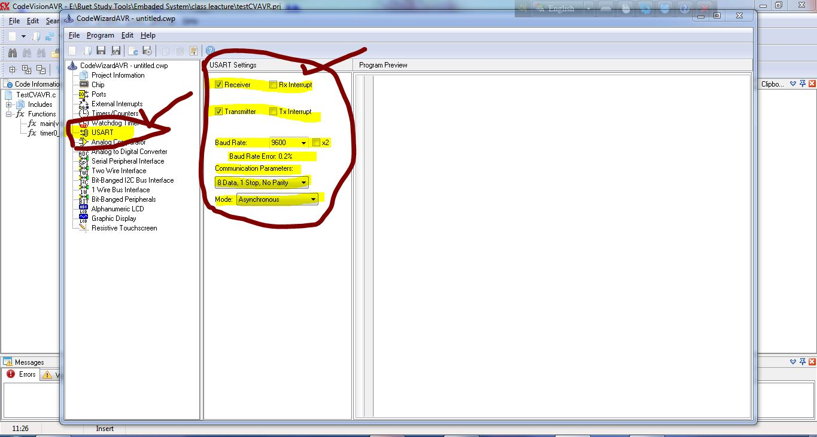
14th Step:

Slide 16
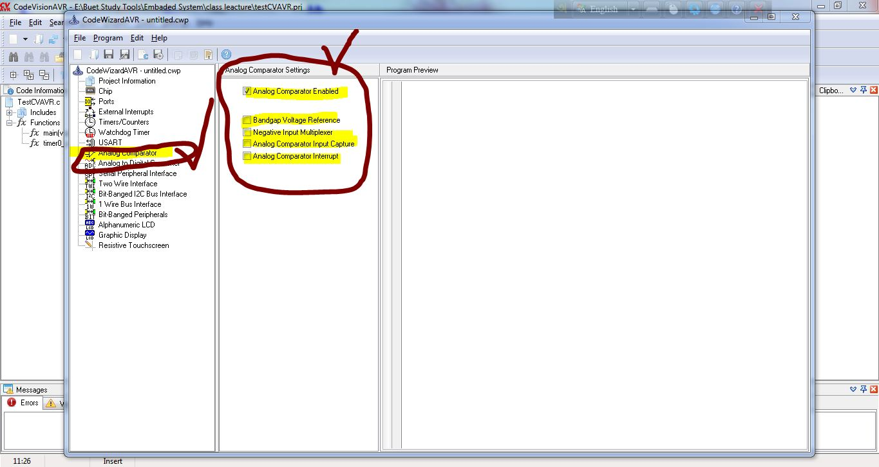
15th Step:

Slide 17
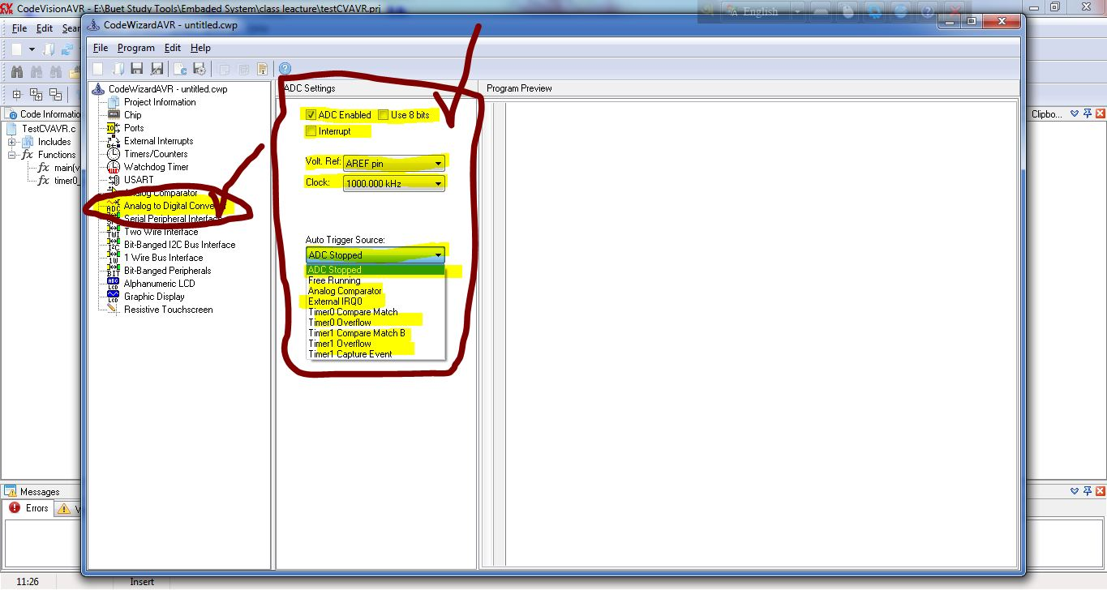
16th Step:

Slide 18
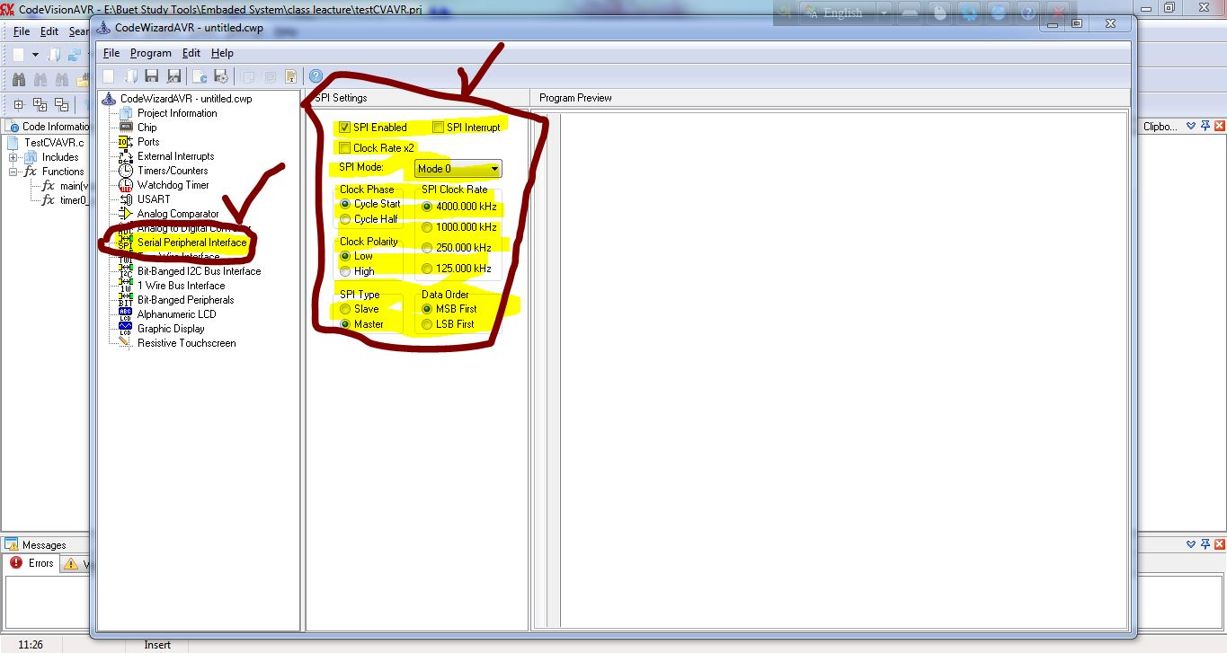
17th Step:

Slide 19
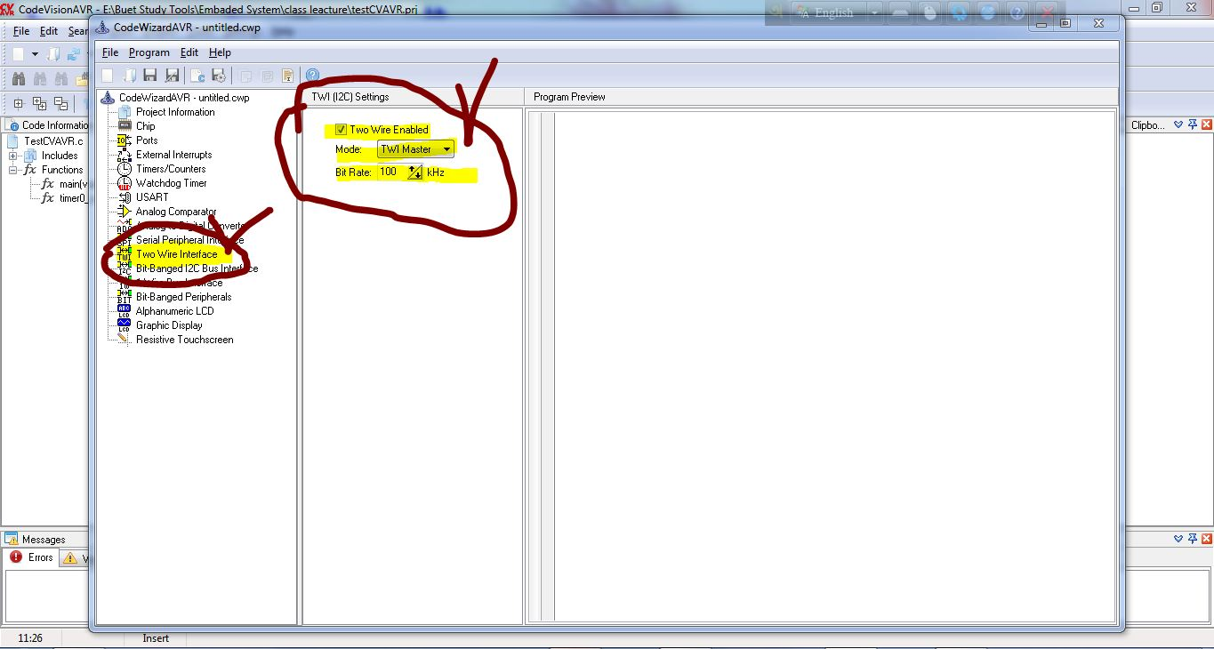
18th Step:

Slide 20
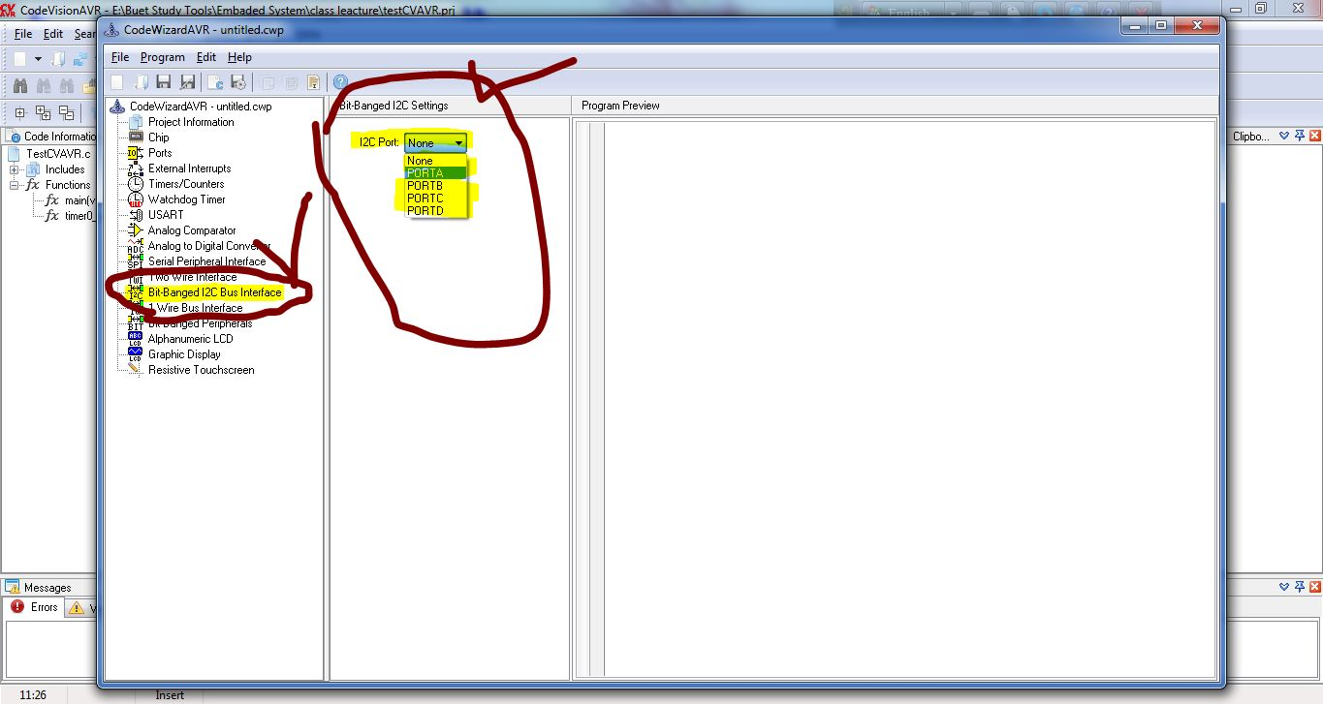
19th Step:

Slide 21
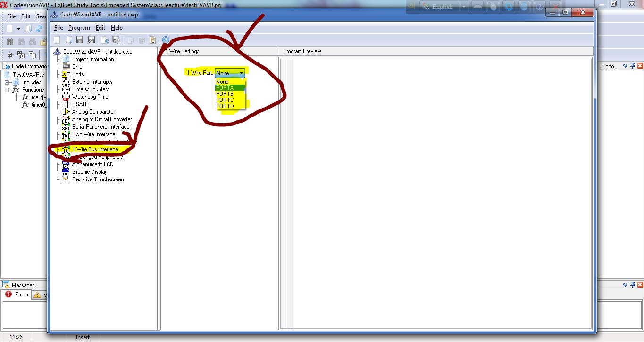
20th Step:

Slide 22
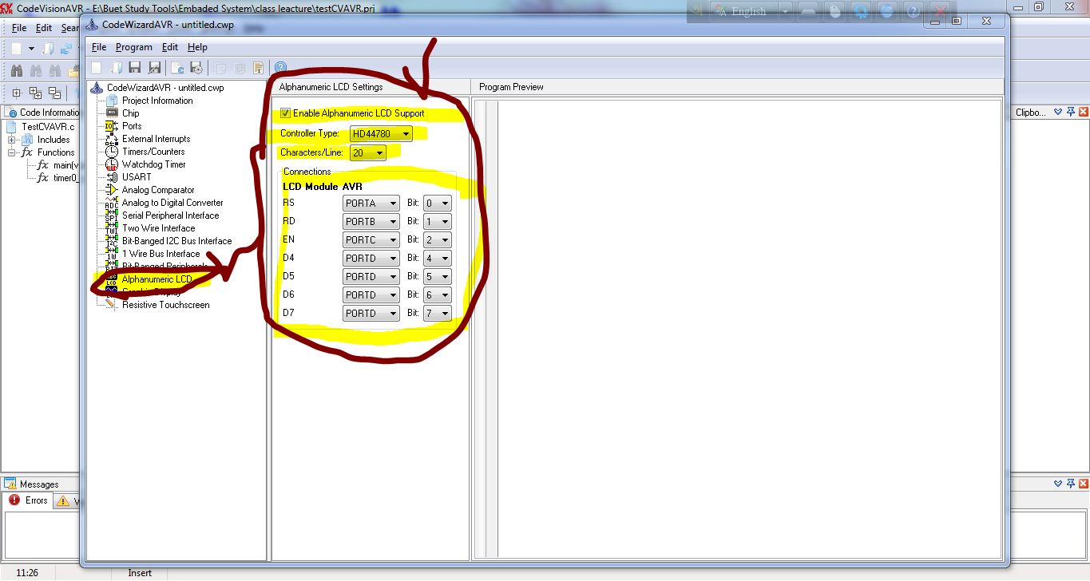
21st Step:

Slide 23
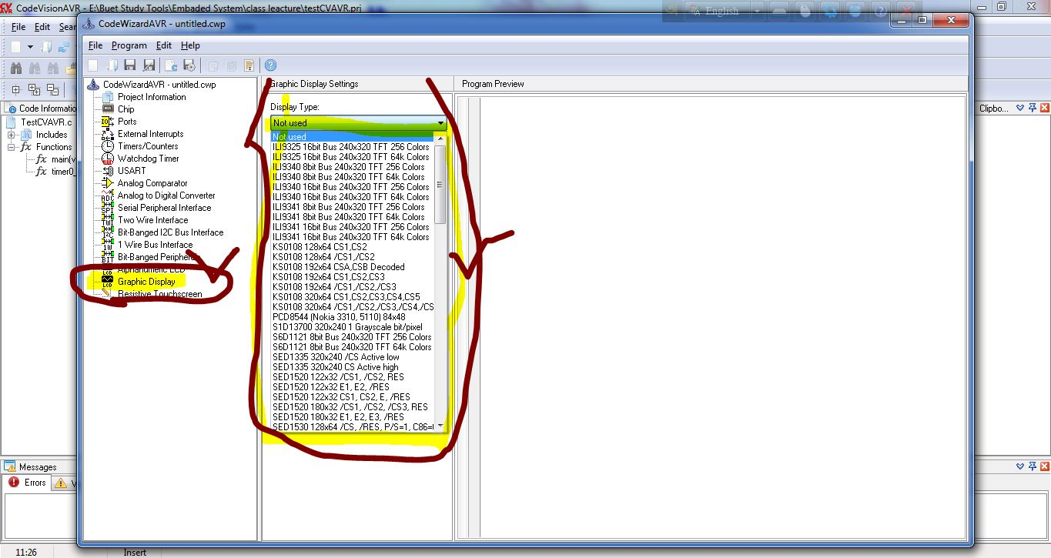
22nd Step:

Slide 24
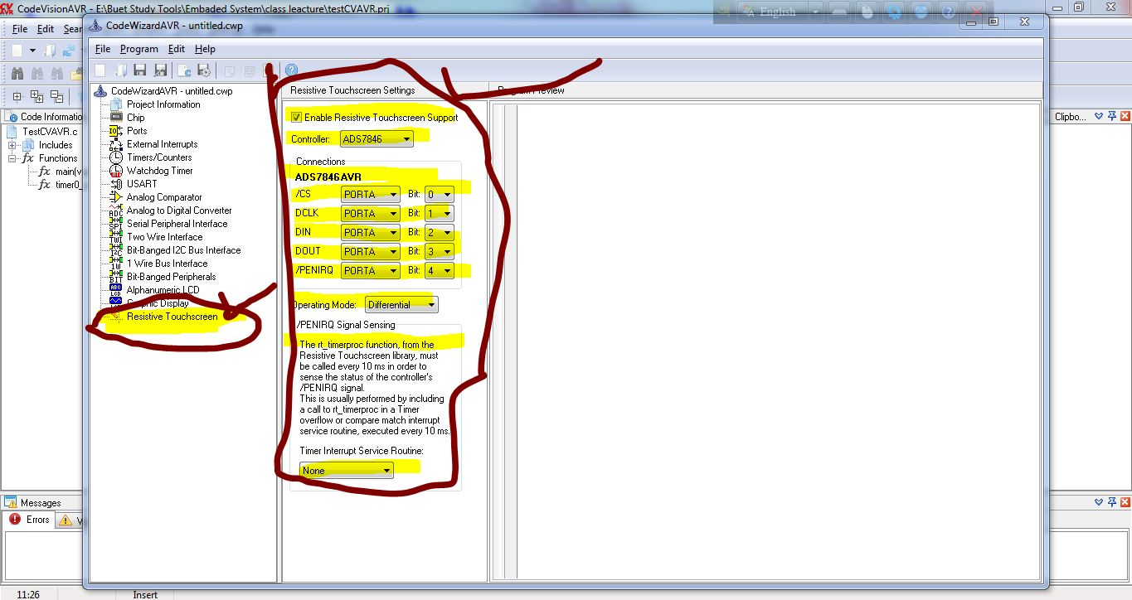
24th Step:

Slide 25
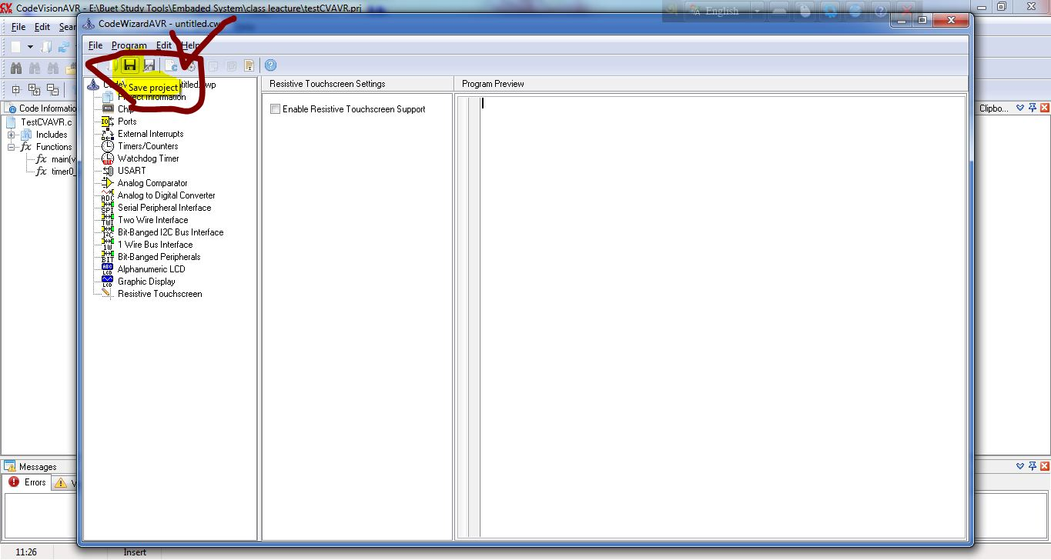
25th Step:

Slide 26
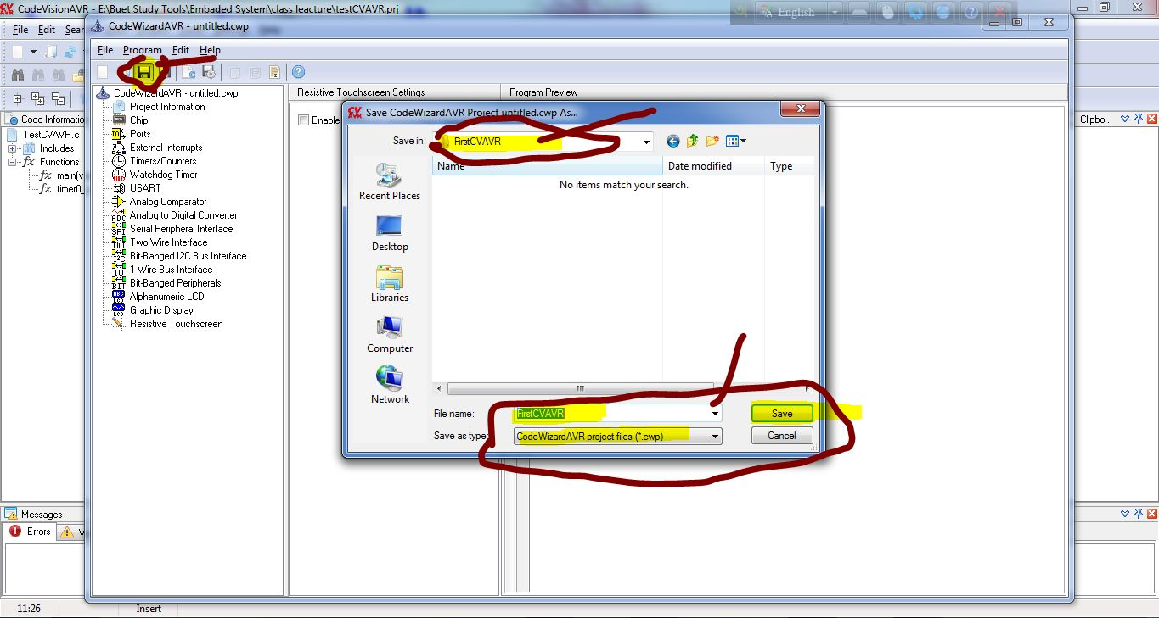
26th Step:

Slide 27
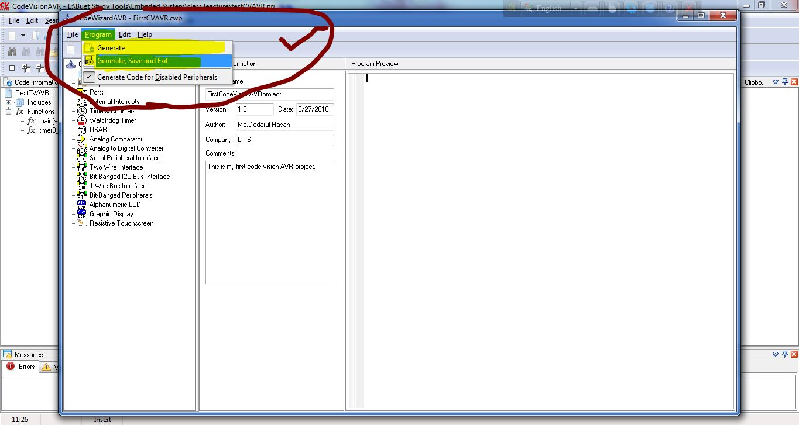
27th Step:

Slide 28
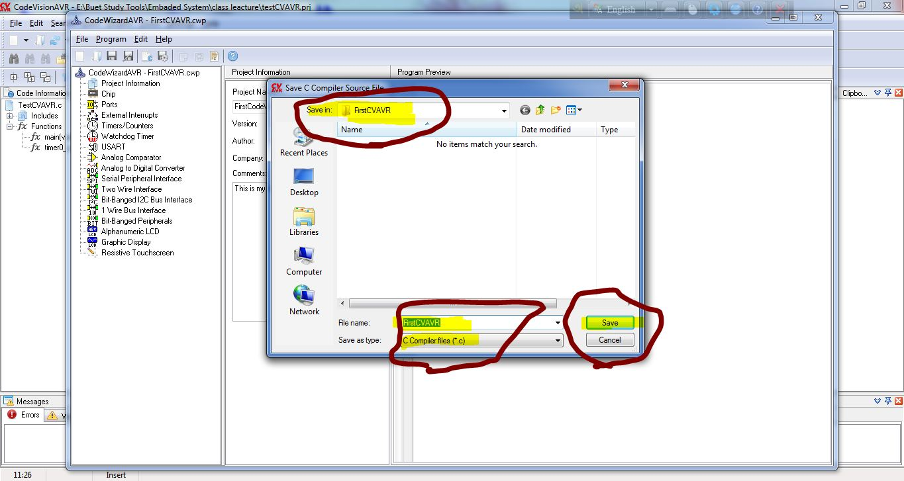
28th Step:

Slide 29
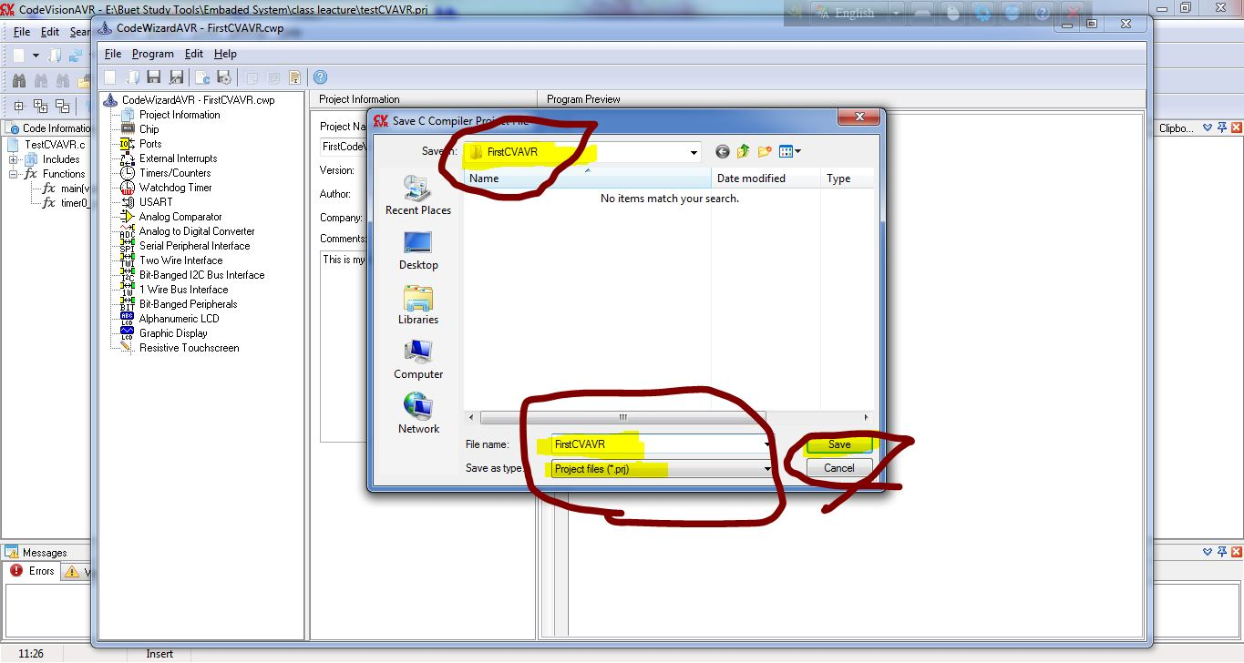
29th Step:

Slide 30
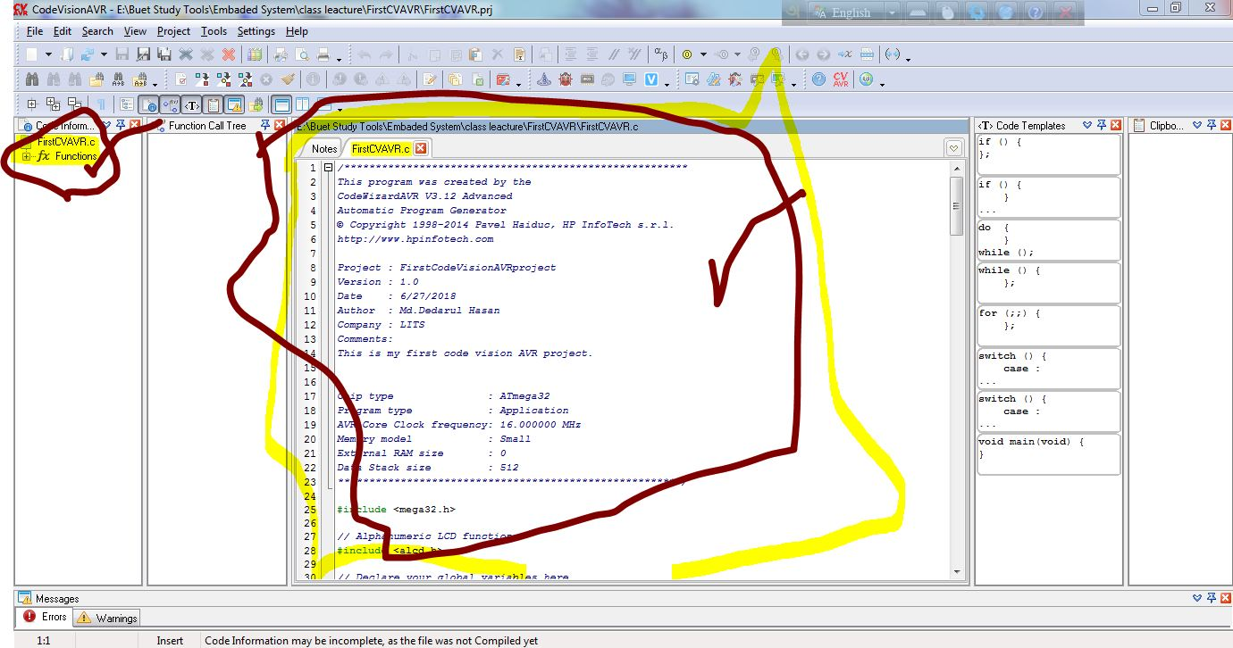
30th Step:

Slide 31
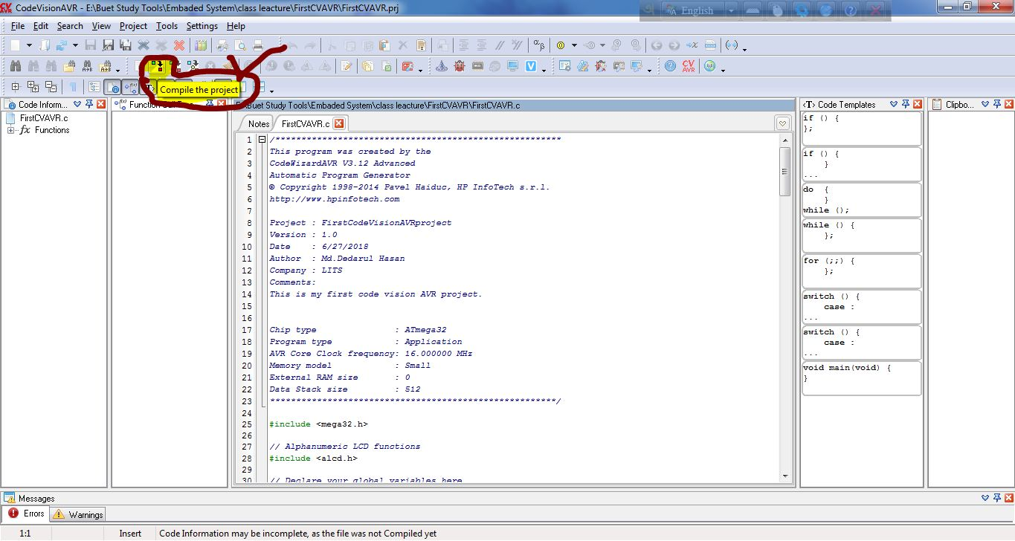
31st Step:

Slide 32
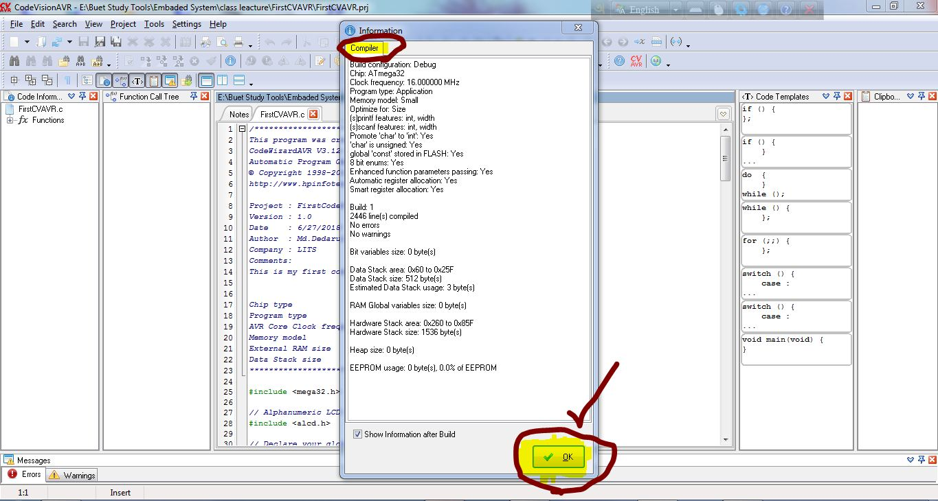
32nd Step:

Slide 33
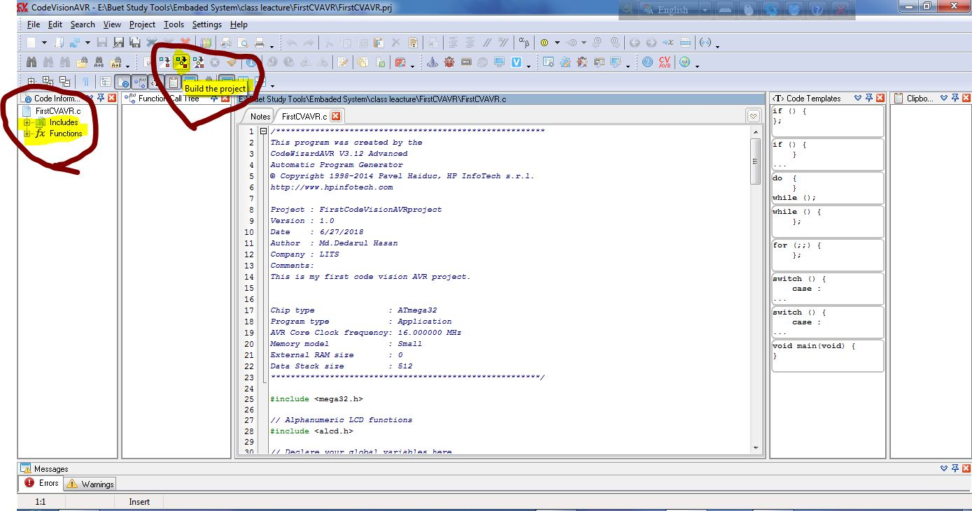
33rd Step:

Slide 34
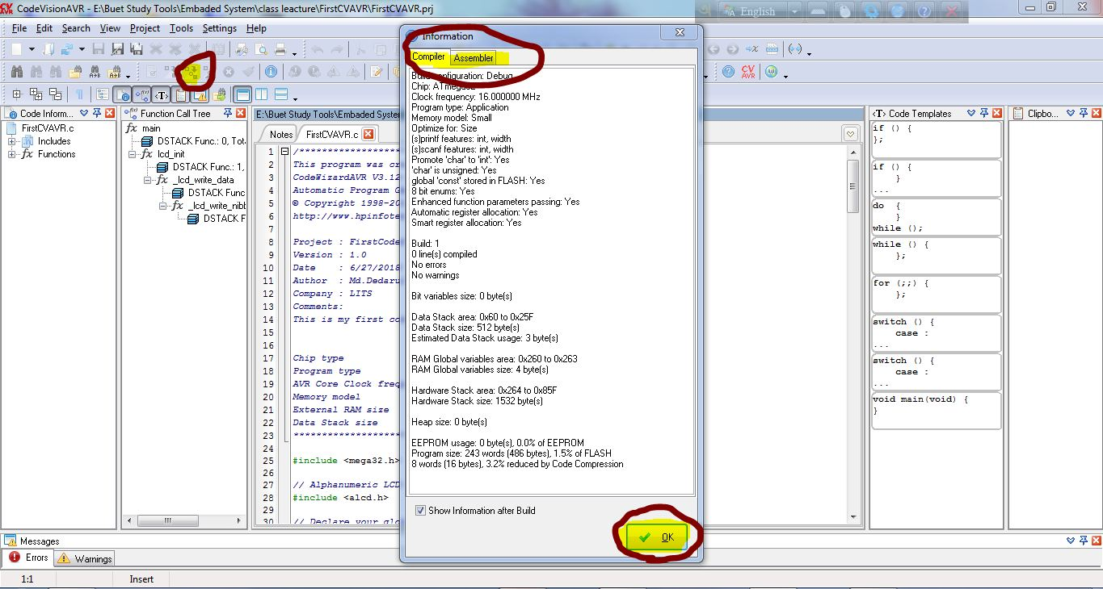
34th Step:

Slide 35
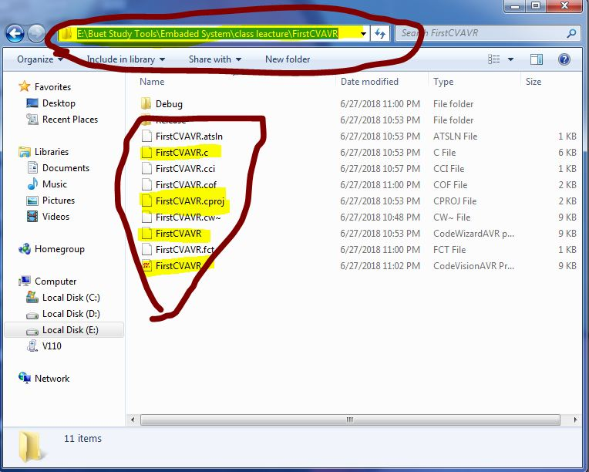
35th Step:

Slide 36
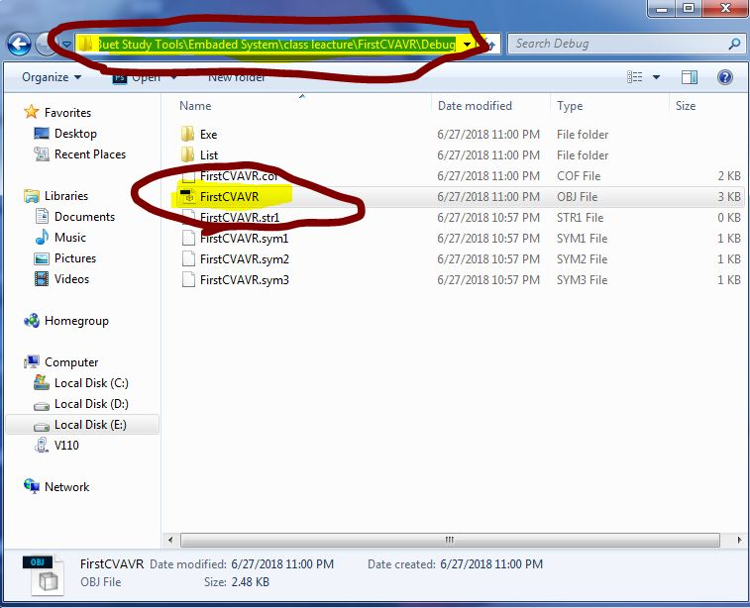
36th Step:

Slide 37
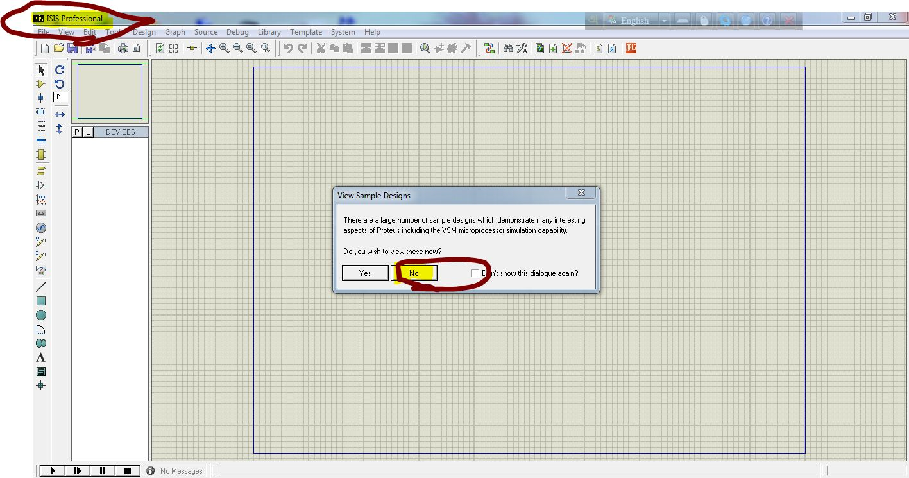
37th Step: Go to simulator ISIS Professional.

Slide 38
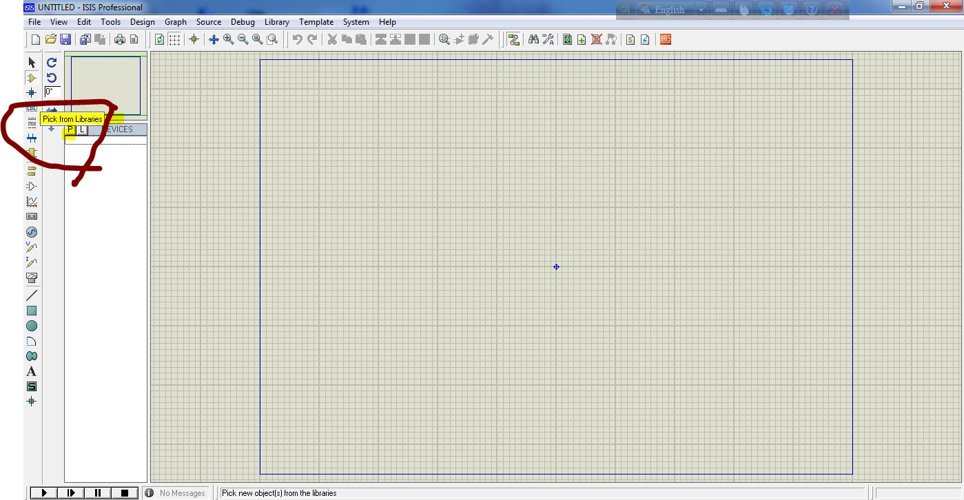
38th Step:

Slide 39
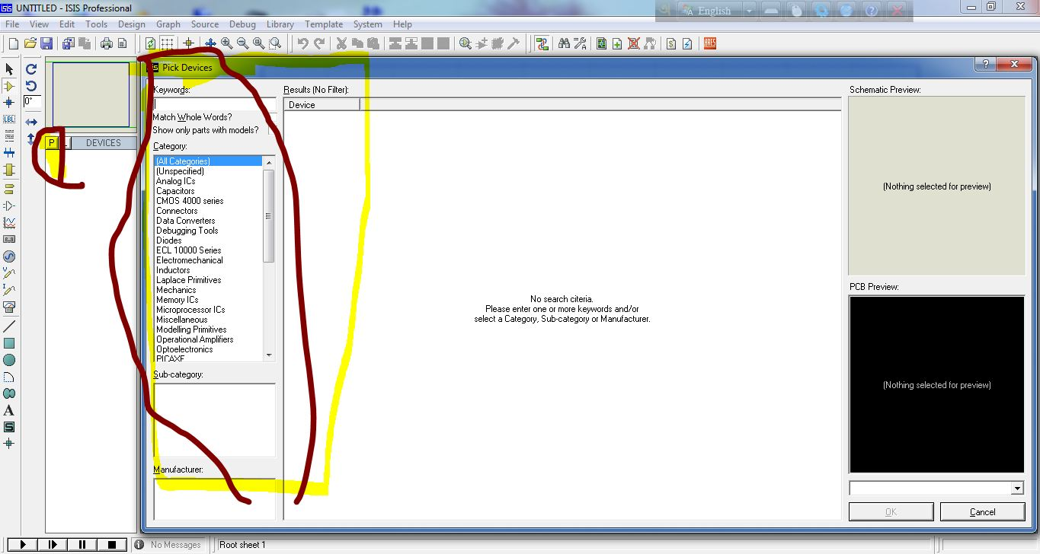
39th Step:

Slide 40
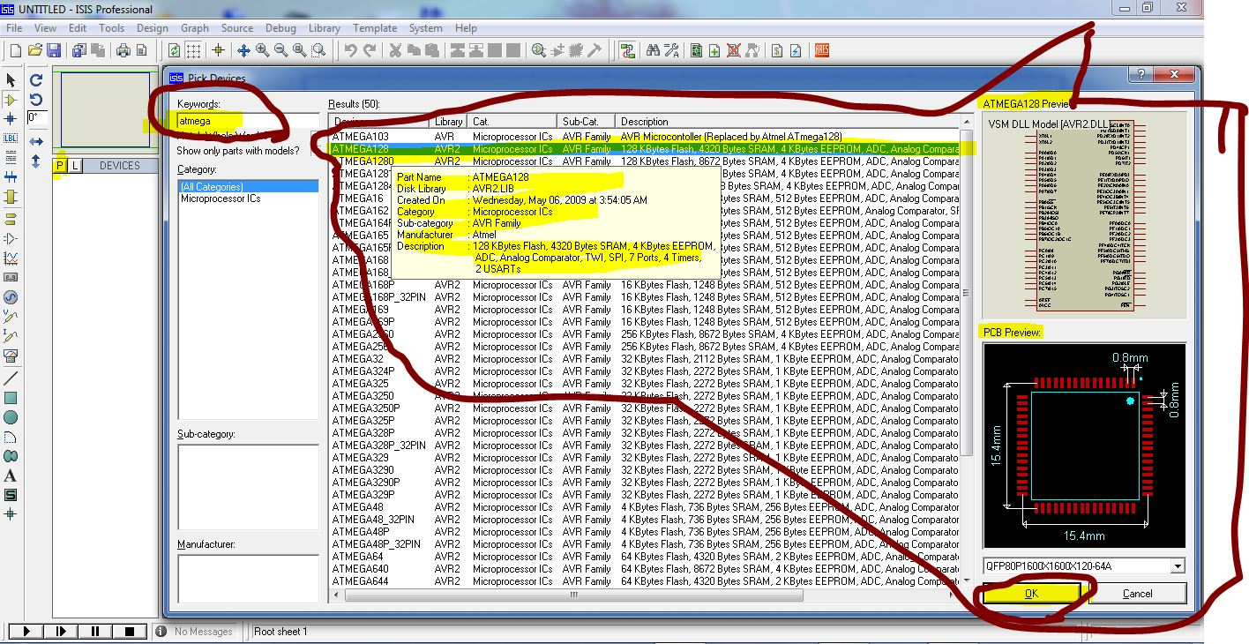
40th Step:

Slide 41
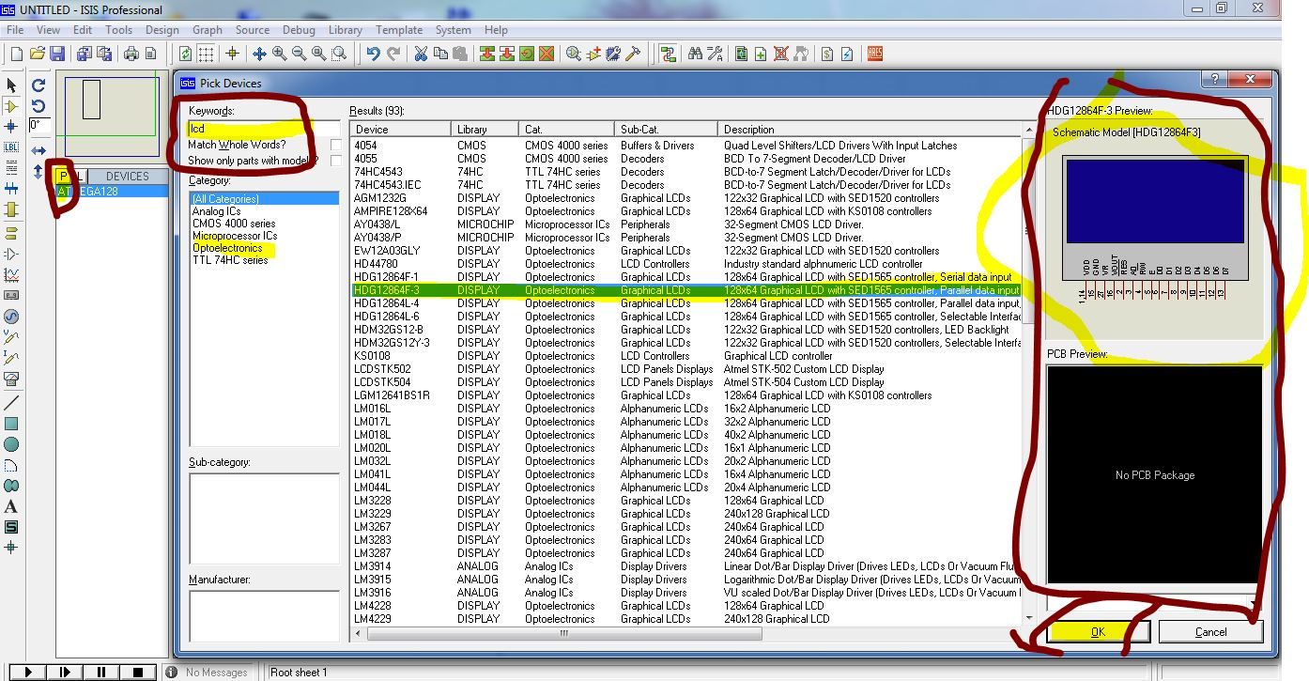
41st Step:

Slide 42
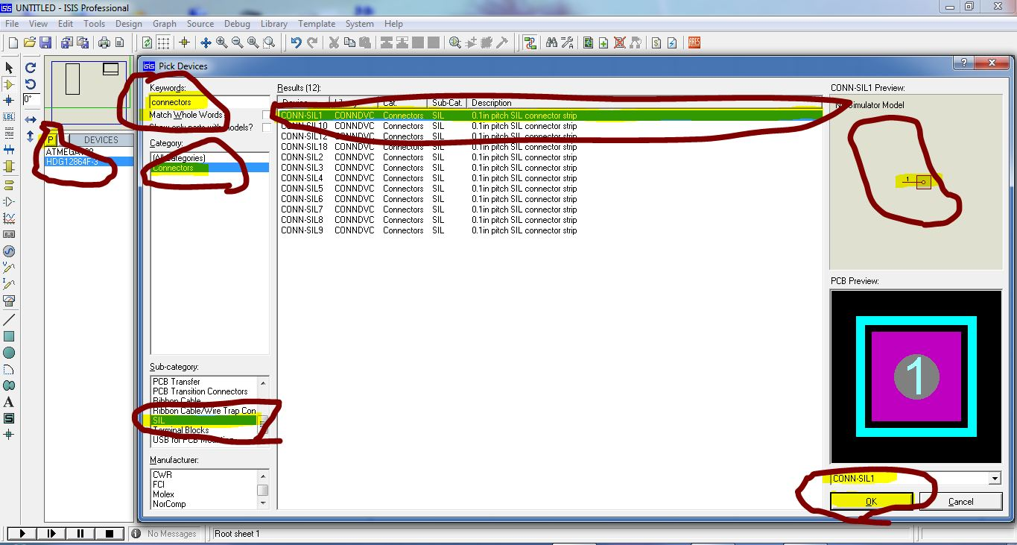
42nd Step:

Slide 43
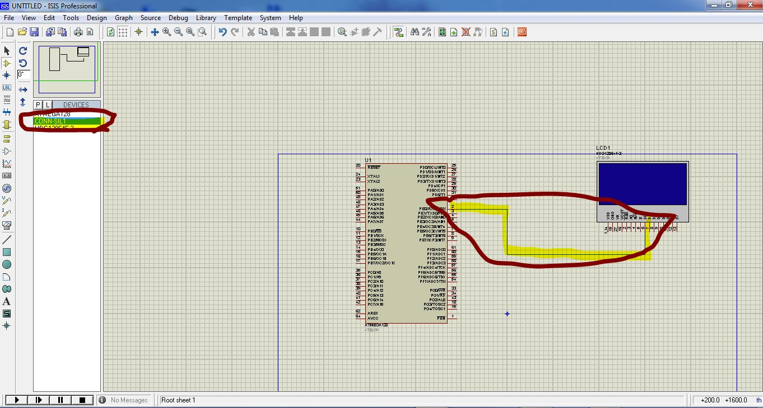
43rd Step:

Slide 44
44th Step:

Slide 45
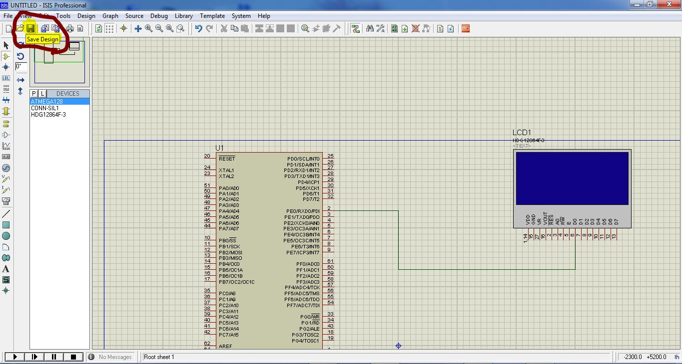
45th Step:

Slide 46
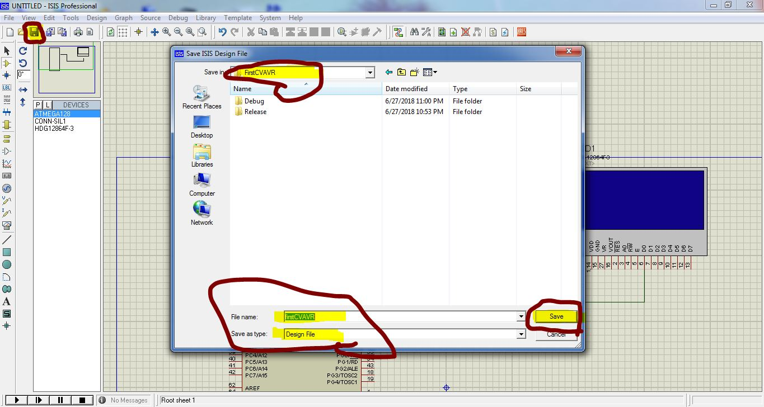
46th Step:

Slide 47
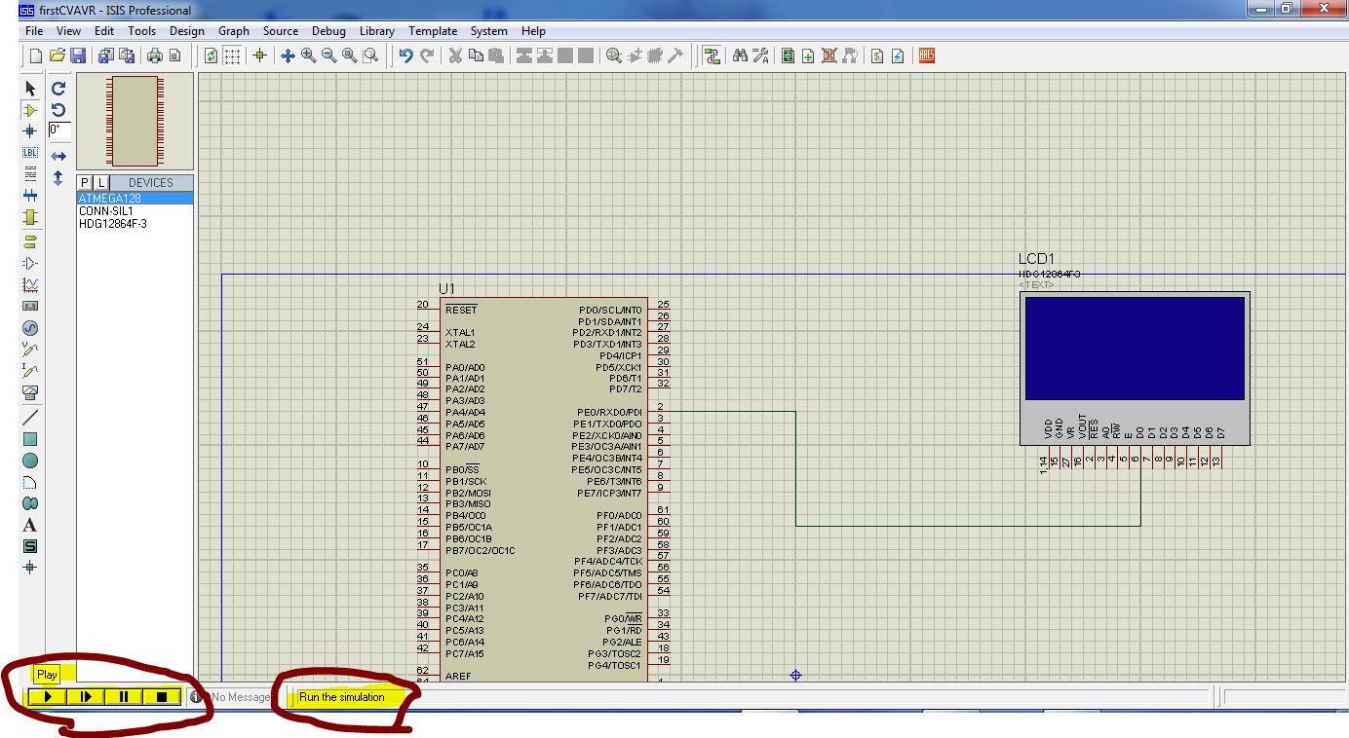
47th Step:

Slide 48
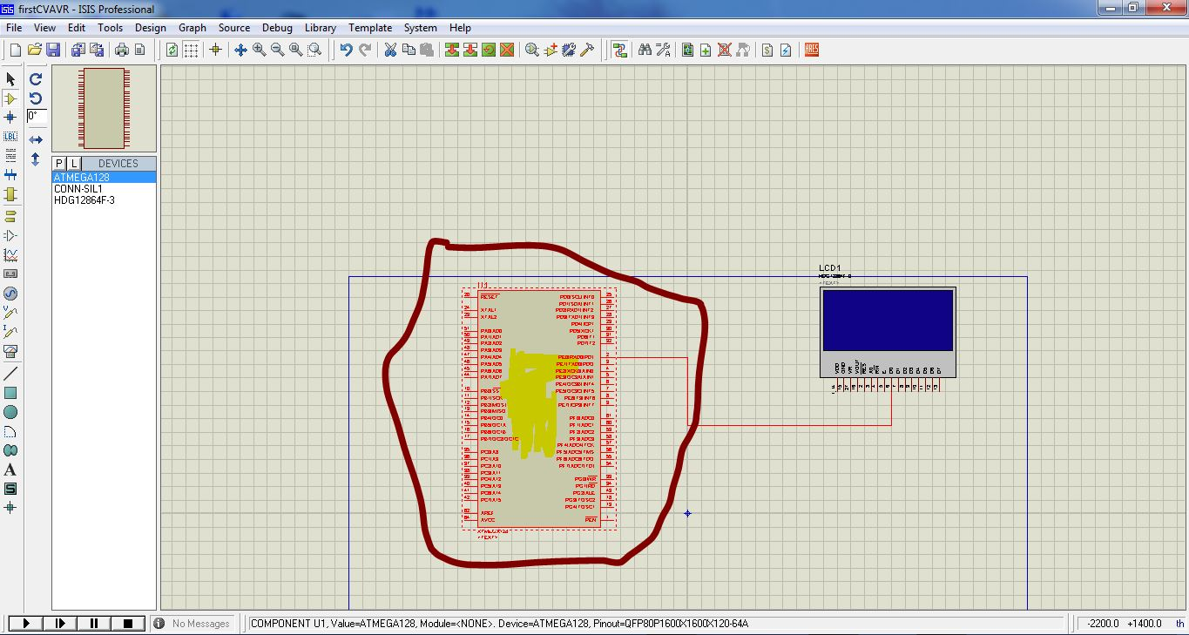
48th Step:

Slide 49
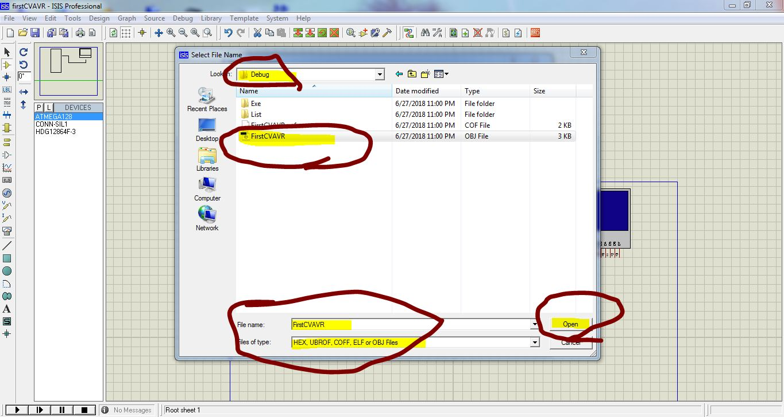
49th Step:

Slide 50
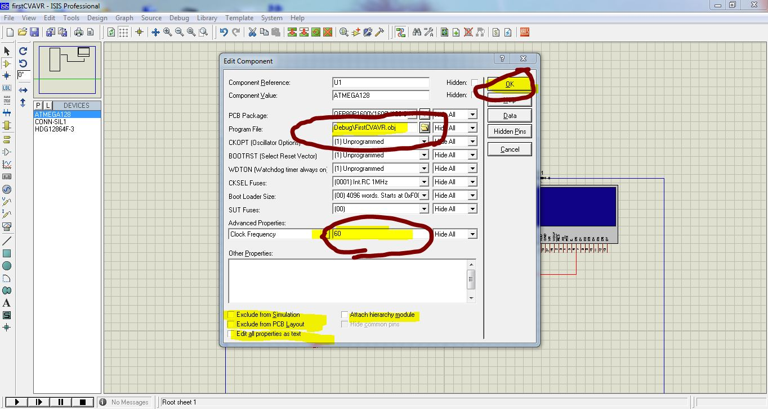
50th Step: Double click on AtMega then configure that .obj file with dirrectroy & Set Clock Frequency 60 Hz.

Slide 51
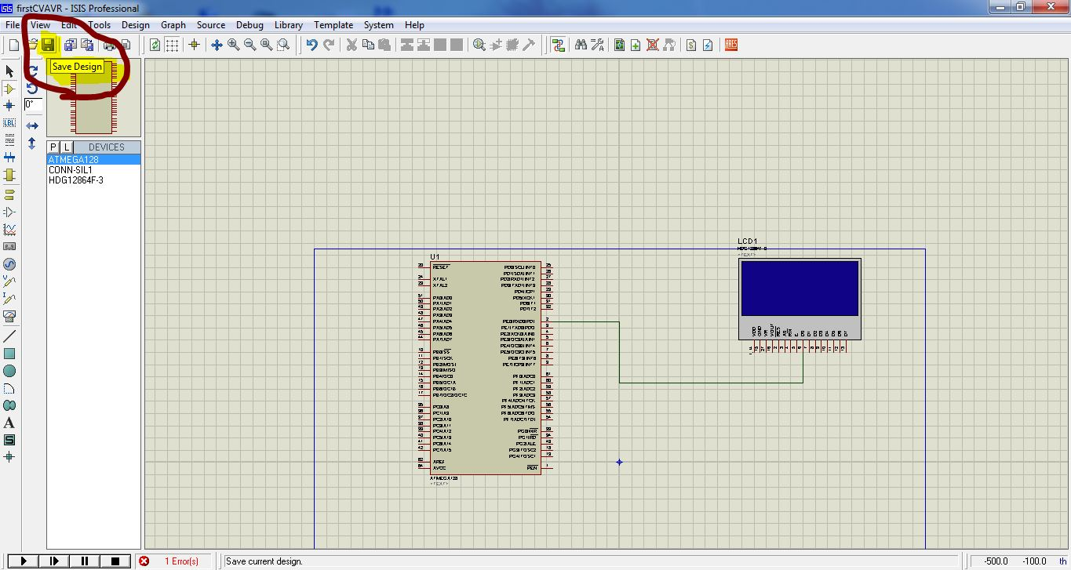
51st Step:

Slide 52
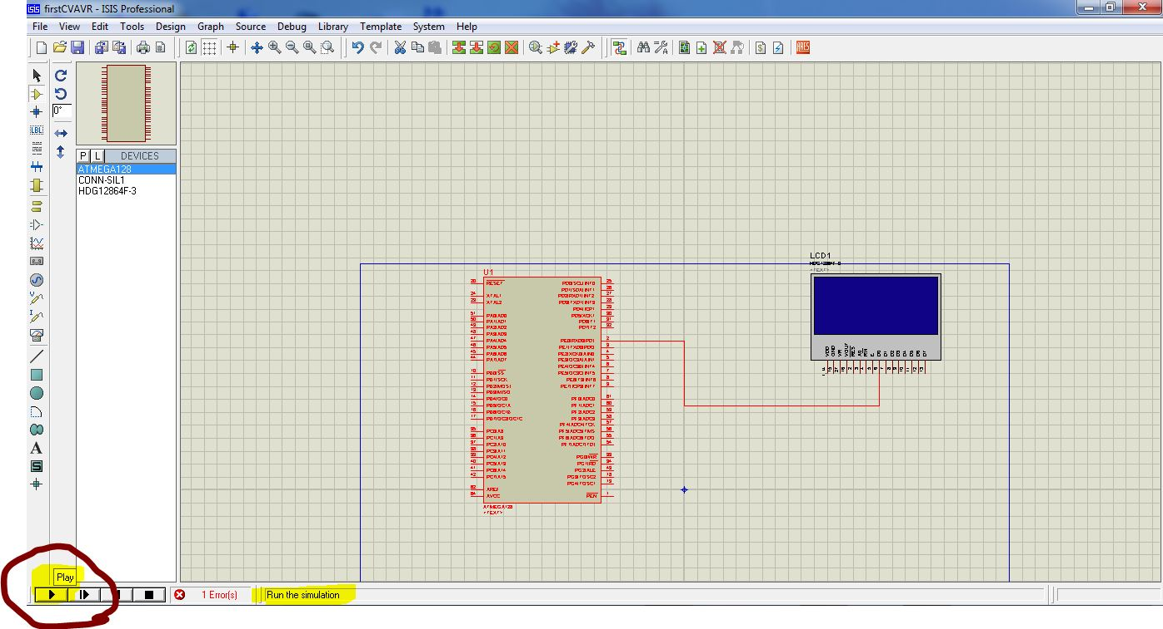
52nd Step:

Slide 53
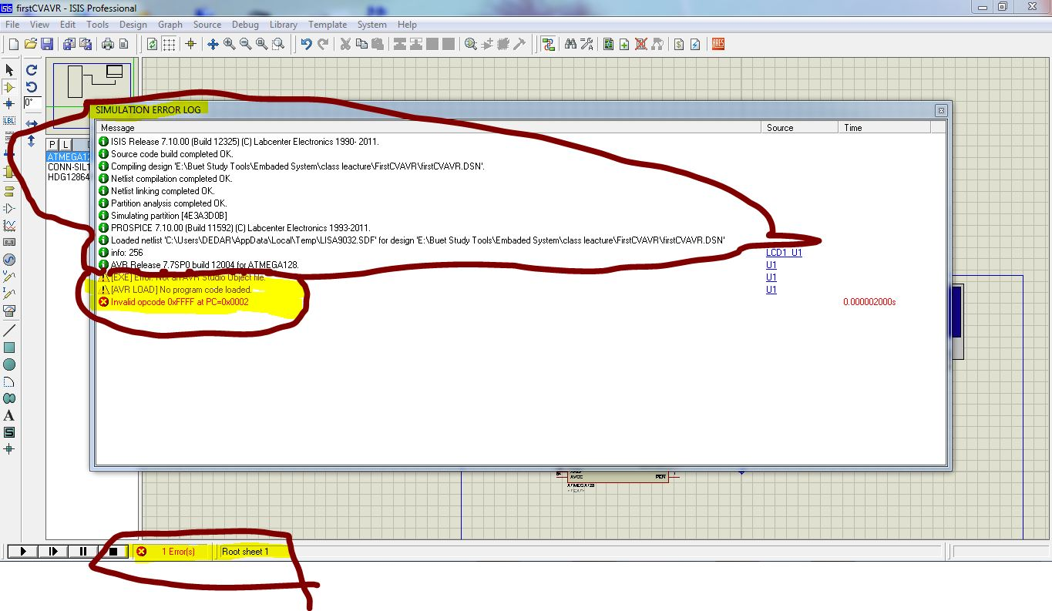
53rd Step: Error shown here as because we didn’t write our program which have to apply on our avr board.So, we have to code here.

Slide 54
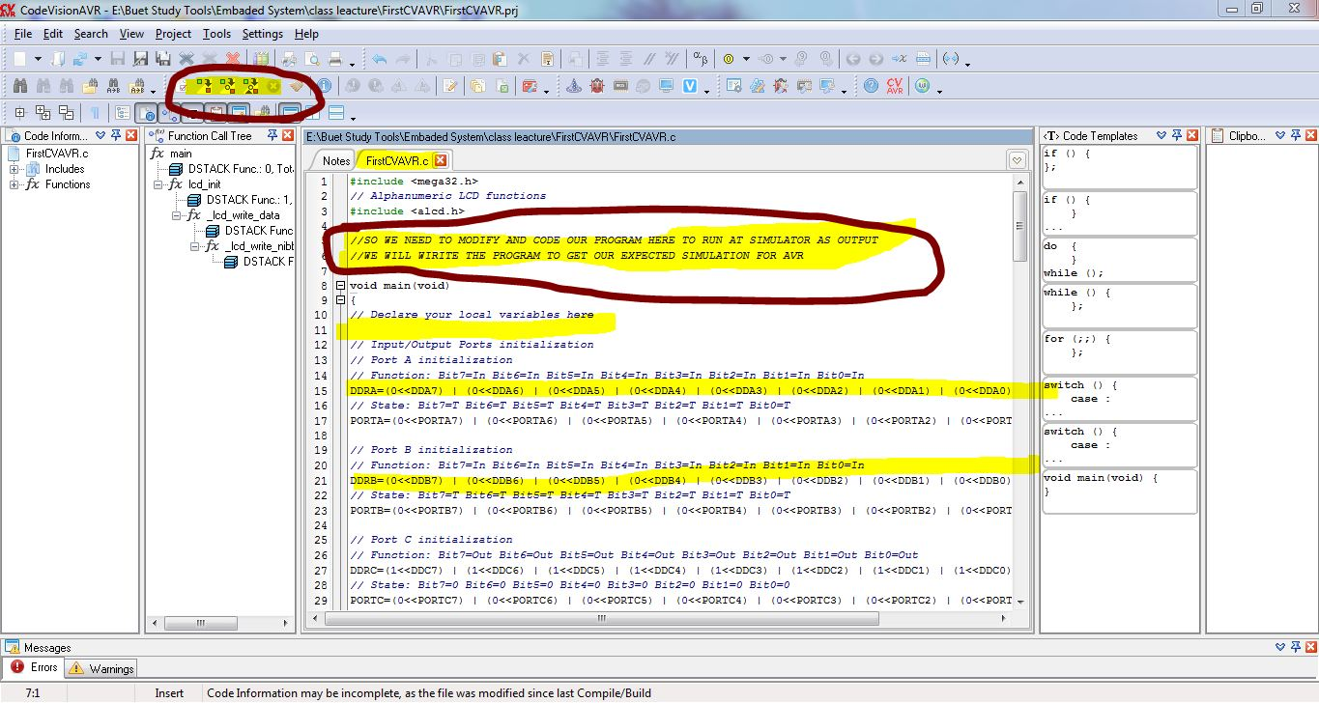
54th Step: So, We code the class file and compile & build ,then test that on eXtreme Burner.

Slide 55

55th Step: Now Install eXtreme Burner to test programms on AVR Board.

Slide 56

56th Step:

Slide 57

57th Step:

Slide 58

58th Step:

Slide 59

59th Step:

Slide 60

60th Step:

Slide 61

61st Step:

Slide 62

62nd Step:

Slide 63

63rd Step:

Slide 64

64th Step:

Slide 65

65th Step:

Slide 66
66th Step:

Slide 67
Pros & Cons:
Ours hands on topic should be practice next using that manual step by step system design of ESD.

